Slide 1
Chronic Wasting Disease
NREC March 1st, 2018

Slide 2
Transmissible Spongiform Encephalopathy
Cattle – BSE
Sheep – Scrapie
CWD – some Cervids
Others in Mink, Cats, etc.

Slide 3
History of CWD
• First identified in elk of wild origin in the mid 1960’s at Colorado State University
• The origin of CWD is unknown
• Hypotheses:
a natural disease of elk and deer
from scrapie infected sheep
deer/elk fed pelleted feed with TSE in it
spontaneous genetic mutation deer prion

Slide 4
History of CWD
2002 – CWD Response Plan developed
2008 – first captive deer found positive for CWD in Michigan (Kent County). Lower Peninsula baiting ban initiated.
2012 – CWD Response plan revised
2015 – First free ranging deer positive for CWD (Ingham County). Core and management zones created. CWD later identified in Clinton county deer also.
2015-16: 4 positive deer in Clinton Cty, 5 positive in Ingham
2017 – CWD found in Mecosta County cervid facility (may have been wild deer heads)
2017 – CWD identified in Montcalm and Kent Co free ranging deer (36 positives in Montcalm County in 2017). No positives in these counties prior to 2017.
2017 – CWD identified in second Mecosta cervid facility
Feb. 7 2018 – Latest update on CWD numbers is 57 deer. No new suspect/positive deer since mid-January update.

Slide 5
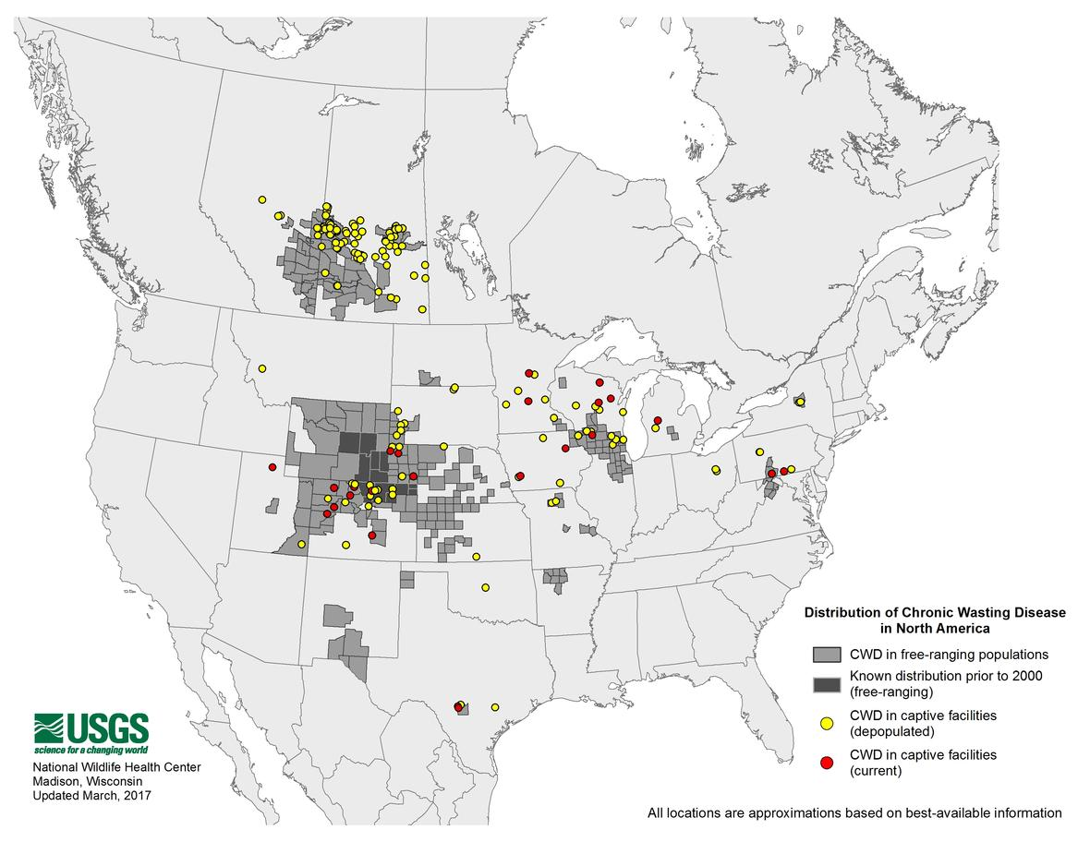

Slide 6
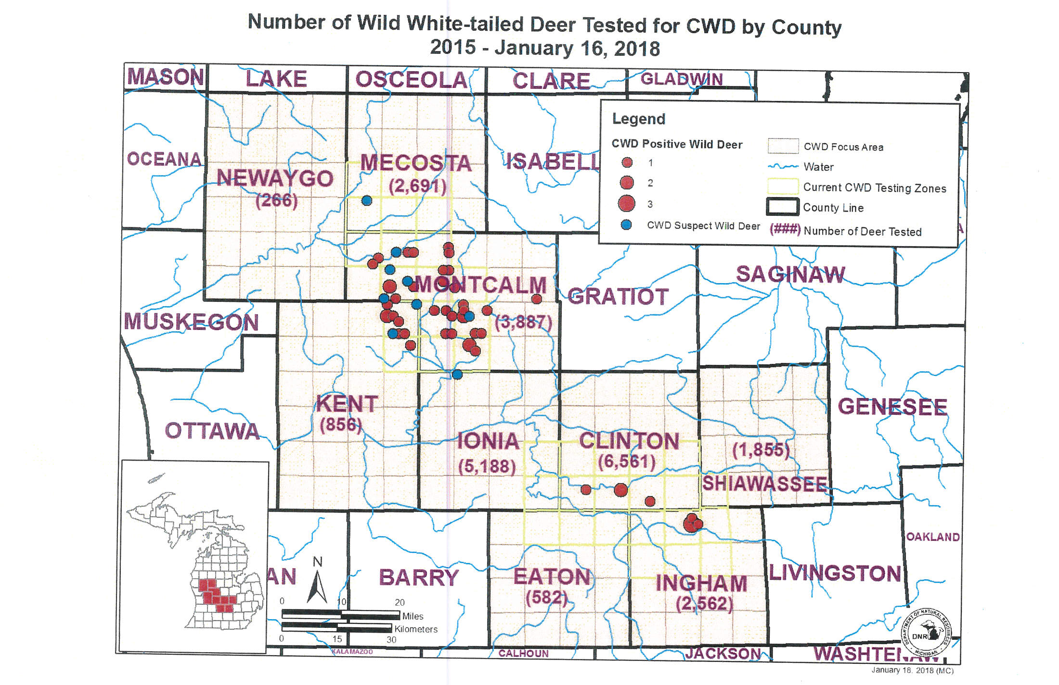

Slide 7
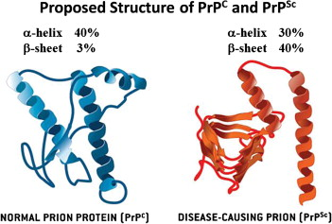
What is “CWD”
NOT LIVING
CAN’T “KILL”
Prion Protein (PrP) – A normal protein found in most cells, but more frequent in nervous system.
PrP^{cwd} – Mutated version of protein. Mutation causes protein to mutate other normal PrP it encounters.

Slide 9
Transmissibility of CWD
Ingestion of infectious prions via close contact, contaminated food/environment, or in-vitro (mother to offspring)
Tonsils-lymph-PNS-CNS
Infectious prions mutate “normal” prions (PrP to PrP^{cwd} )
Infectious prions build up and destroy cells, leaving “holes” in brain
2-4 years between infection of animal and clinical symptoms

Slide 10
Transmissibility of CWD to Humans
No evidence that CWD is transmissible to humans despite the frequent and long term (30+ years) consumption of venison
Increases in CJS in Wisconsin likely not related
Macaques study inconclusive
Absence of evidence does not indicate safety, merely suggests there is no acute effect
Further mutations possible (how Mad Cow formed)

Slide 11
Variability in Transmission
• Direct: (animal to animal)
• Indirect: (animal to environment to animal)
• Direct probably more important early, indirect late
• Role of dose

Slide 12
Genetic Component
Genetic Resistance to CWD
• Naturally occurring genetic variation (PRNP gene) exists within deer and elk populations
• Natural resistance does not appear to be complete.

Slide 13
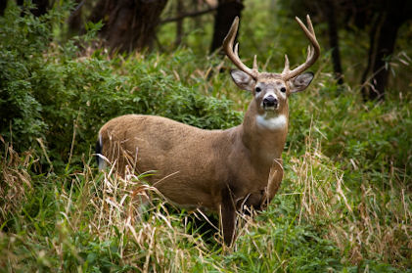
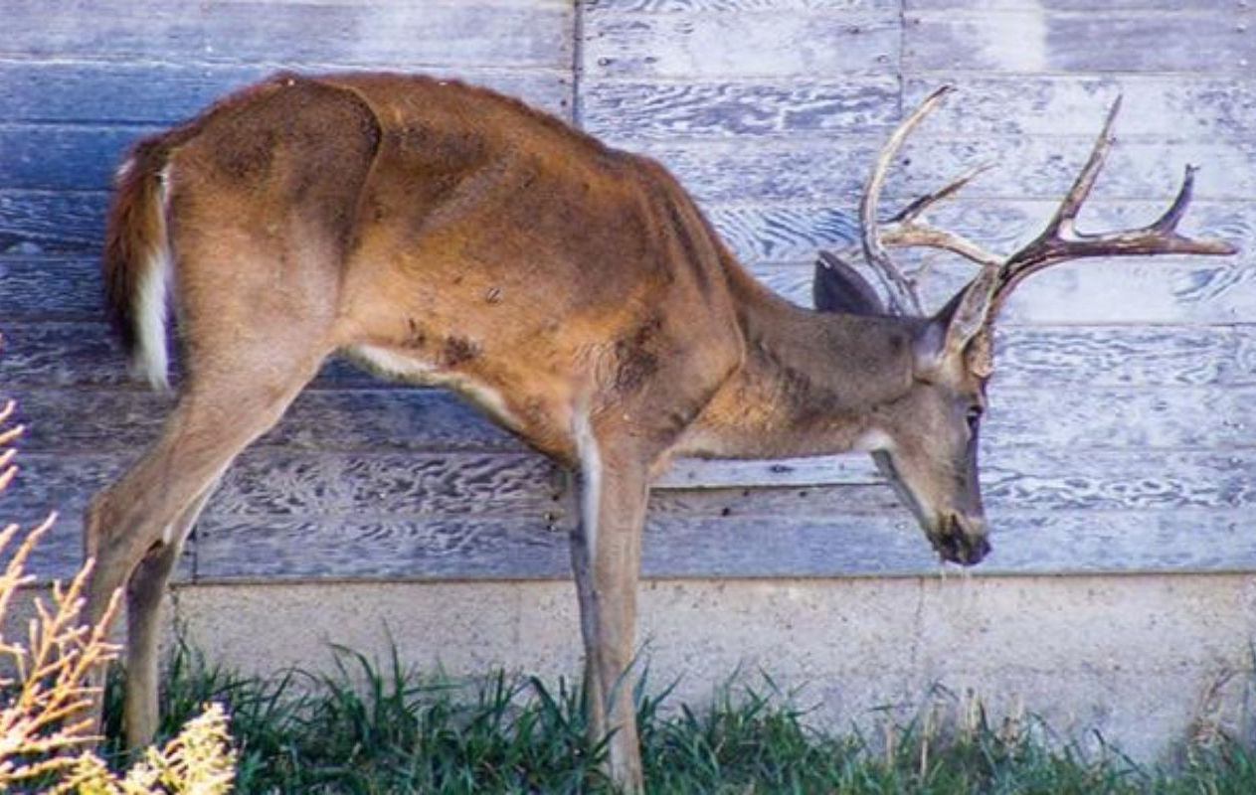
Clinical Signs of CWD

Slide 14
Clinical Signs of CWD
Change of behavior
Head tremors
May carry head and ears lowered
Wide body stance
Walking repetitive path
Pneumonia is commonly found in antemortem testing
Reduced appetite
Loss of body weight (poor condition)
Excessive drinking and urination
Increased salivation/slobbering/drooling
Incoordination, ataxia, head tremors

Slide 15
Facts on CWD
Effects adults 17 months to 15+ years
Most 3-5 years old, or >15 years
Both sexes
No seasonality
17 month minimum incubation period
Infected individuals more likely to be hit by cars, killed by predators/hunters.

Slide 16
Diagnostic Tests for CWD
ELISA-based tests (enzyme linked immunosorbent assay)
Approximately $30-$40/test
Antemortem Test: Tonsillar and rectal biopsy test using IHC technology
Others in development

Slide 17
Prevention of CWD
No vaccines currently available
Preventing spread/concentration of environmental contamination
Can’t stop natural migration of deer

Slide 18
Learning from Neighbors?
Populations in Colorado and Wyoming infected for 30+ years
40-50% prevalence rate
Some seem fine, others are on decline

Slide 19
Next Steps Forward
Coordinating with MDNR/MDARD (at technical and leadership levels)
Testing/Monitoring
Management Strategies (comment on NRC Recs)
Funding
Education of Membership
CWD
Need for management
How to have deer tested
How to help limit the spread

